Slide 1
DOCTORAL QUALIFIER PRESENTATION
An Agentic AI Framework for Early Identification, Longitudinal Monitoring, and Personalized Intervention of Children's Language Difficulties (Orthographic and Phonological) from Malayalam Handwritten Data
Dhanya Sujatha — Research Scholar
Supervisor: Dr. Prema Nedungadi
Amrita School of Computing, Amrita Vishwa Vidyapeetham, Amritapuri · 2026

Slide 2
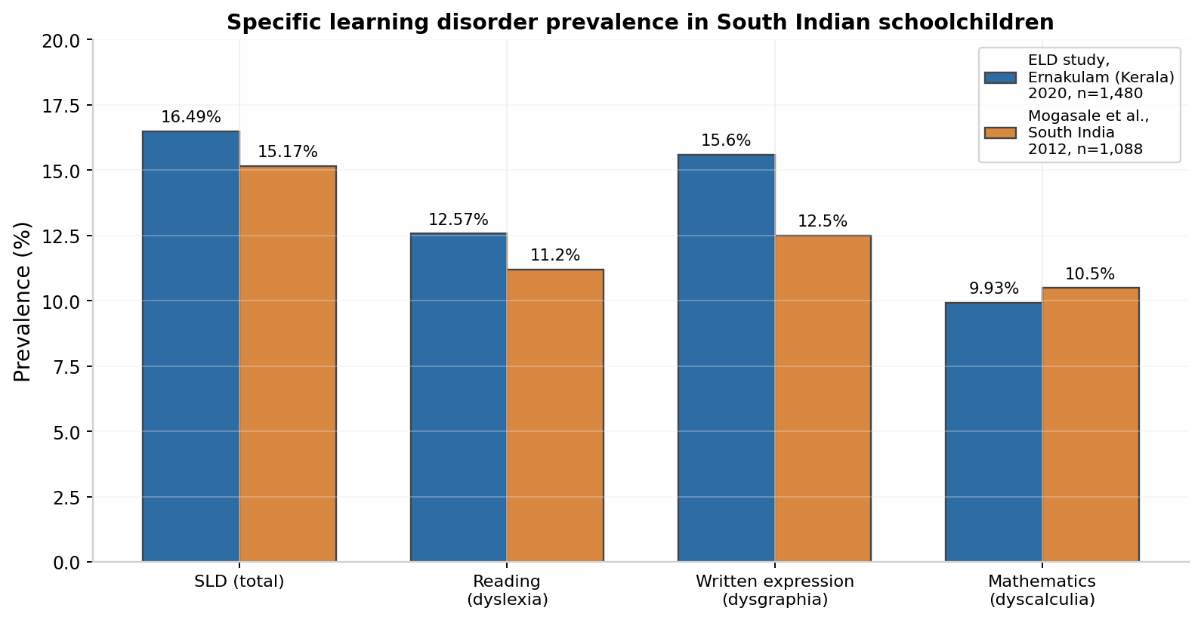
The Problem: An Invisible Population
16.49%
SLD prevalence, Kerala schoolchildren (ELD study, n=1,480)
0 / 244
identified children who had ever been evaluated or received remediation
15.6%
written-expression impairment — the most common SLD subtype
Why this persists:
• A handful of specialists cannot screen lakhs of children with hour-long subjective assessments
• Classroom teachers receive little training to spot these difficulties
• Early identification (ages 4–8) is decisive: structured support at this stage measurably closes literacy gaps
• No early-identification system exists for Malayalam — or any Indian language

Slide 3
Why Handwriting — and Why Malayalam
Handwriting as the sensor
Malayalam as the language
• Produced daily in every classroom — no special equipment beyond a phone camera
• Letters may be cleanly formed, yet what is written is linguistically wrong — the difficulty is in the language system, not the hand
• Jointly encodes orthographic errors, spelling errors, and the child's underlying phonological representation
• Buffalo DDBIC framework (2025): most of 17 dyslexia/dysgraphia indicators are extractable from static handwriting images
• Our target: the language (dyslexia-type) difficulty — phonologically deviant spellings — not motoric penmanship (dysgraphia)
• ~45M speakers; the literacy medium of Kerala children — state-syllabus children carry higher SLD risk (OR 6.97)
• A screening tool must work in the child's medium of instruction
• Near-transparent akshara orthography: spelling errors map directly to phonological causes — more diagnostic than English
• Architecture exploits alphasyllabic structure → transfers to Tamil, Kannada, Telugu, Devanagari; English is out of scope
The core insight: for this application, the child's error is not noise to correct — the error IS the diagnostic data. Any system that auto-corrects destroys the signal.

Slide 4
Research Gap: Four Streams, One Missing Link
Stream | Representative work | What is missing
Handwriting-based dyslexia / dysgraphia screening | DDBIC (Buffalo 2025); SAU-Net; TestGraphia; Asselborn et al. | English/Latin, adult focus; binary has/disorder labels; stops at screening — no intervention loop
Malayalam / Indic handwritten recognition | HERA (this scholar, under review); DSC+Bi-LSTM; CNN-based MHCR | Prior work trains on correct adult writing — punishes error preservation; only HERA preserves errors, and stops at word level
Grapheme–phoneme / phonological analysis | OSUR-G2P (this scholar, under review); mlphon FST | mlphon rejects 43.5% of learner spellings; clinical error analysis is manual and English-centric; no longitudinal profiling
Agentic AI in education | LLM-agent surveys; GenMentor; RL multi-agent ITS | No agent consumes handwriting-derived evidence; none targets early-literacy children; none in an Indic language; none RTI-grounded
Gap: nothing connects error-preserving recognition → linguistic error profiling → agent-delivered, monitored intervention — in any language. My two works (under review) close the first two links; the third link is the doctoral contribution.

Slide 5
"Can LLMs Not Just Do This?" — We Measured It
System | Approach | CER ↓
HERA (ours) | Retrieval-only | 0.20
Gemini 2.5 Pro | Generative VLM | 0.388
Sarvam AI | Indic VLM | 0.441
PaddleOCR (FT) | Supervised CNN | 0.528
PaddleOCR (std) | Supervised CNN | 0.621
GPT-5.1 | Generative LLM | 0.786
Claude Opus 4 | Multimodal LLM | 0.800
Three-level answer:
1. Perception fails, measurably. Frontier VLMs/LLMs reach 20–61% character accuracy where HERA reaches 80% — and they fail by auto-correcting the child's errors away.
2. The cause is structural. The language prior is baked into decoding — strict "do not correct" prompting does not switch it off. mlphon likewise rejects 43.5% of learner spellings.
3. So LLMs take their proper role. Reasoning over verified evidence, planning, content, explanation — on top of a deterministic evidence chain they cannot replace.
Design principle: error preservation must be architectural, not prompted.
Agents orchestrate deterministic tools (HERA, OSUR-G2P, statistics) — they do not perceive or compute trends in-context.

Slide 6
Problem Statement
Orthographic and phonological language difficulties are the most prevalent yet least screened form of SLD among Indian primary-school children — and they surface in everyday handwriting, where the letters may be well-formed but what is written is linguistically wrong. Handwriting is the sensor, not the disorder. Existing computational approaches (a) target English/Latin adult handwriting, (b) auto-correct away the very errors that carry the diagnostic signal, and (c) stop at one-time detection — a binary label — with no explanation of which difficulties the child shows, and no tracking of whether help is working.
This research proposes an identification–insight–monitoring framework: error-preserving recognition (HERA) and error-preserving G2P (OSUR) feed an agentic diagnostic layer holding a longitudinal learner model; each new sample is compared against the child's own history to produce actionable insights and progress verdicts; an agentic intervention layer delivers personalized, tiered remediation measured by the same pipeline — a closed loop under teacher supervision, transferable to other akshara scripts.
🔍
Which difficulties?
Specific orthographic vs phonological error patterns, classified against a diagnostic schema
🎯
What to work on?
Teacher-actionable, evidence-traced insights — priorities, not labels
📈
Is it working?
Improving / stagnant / worsening — each child vs their own history, not just population norms

Slide 7
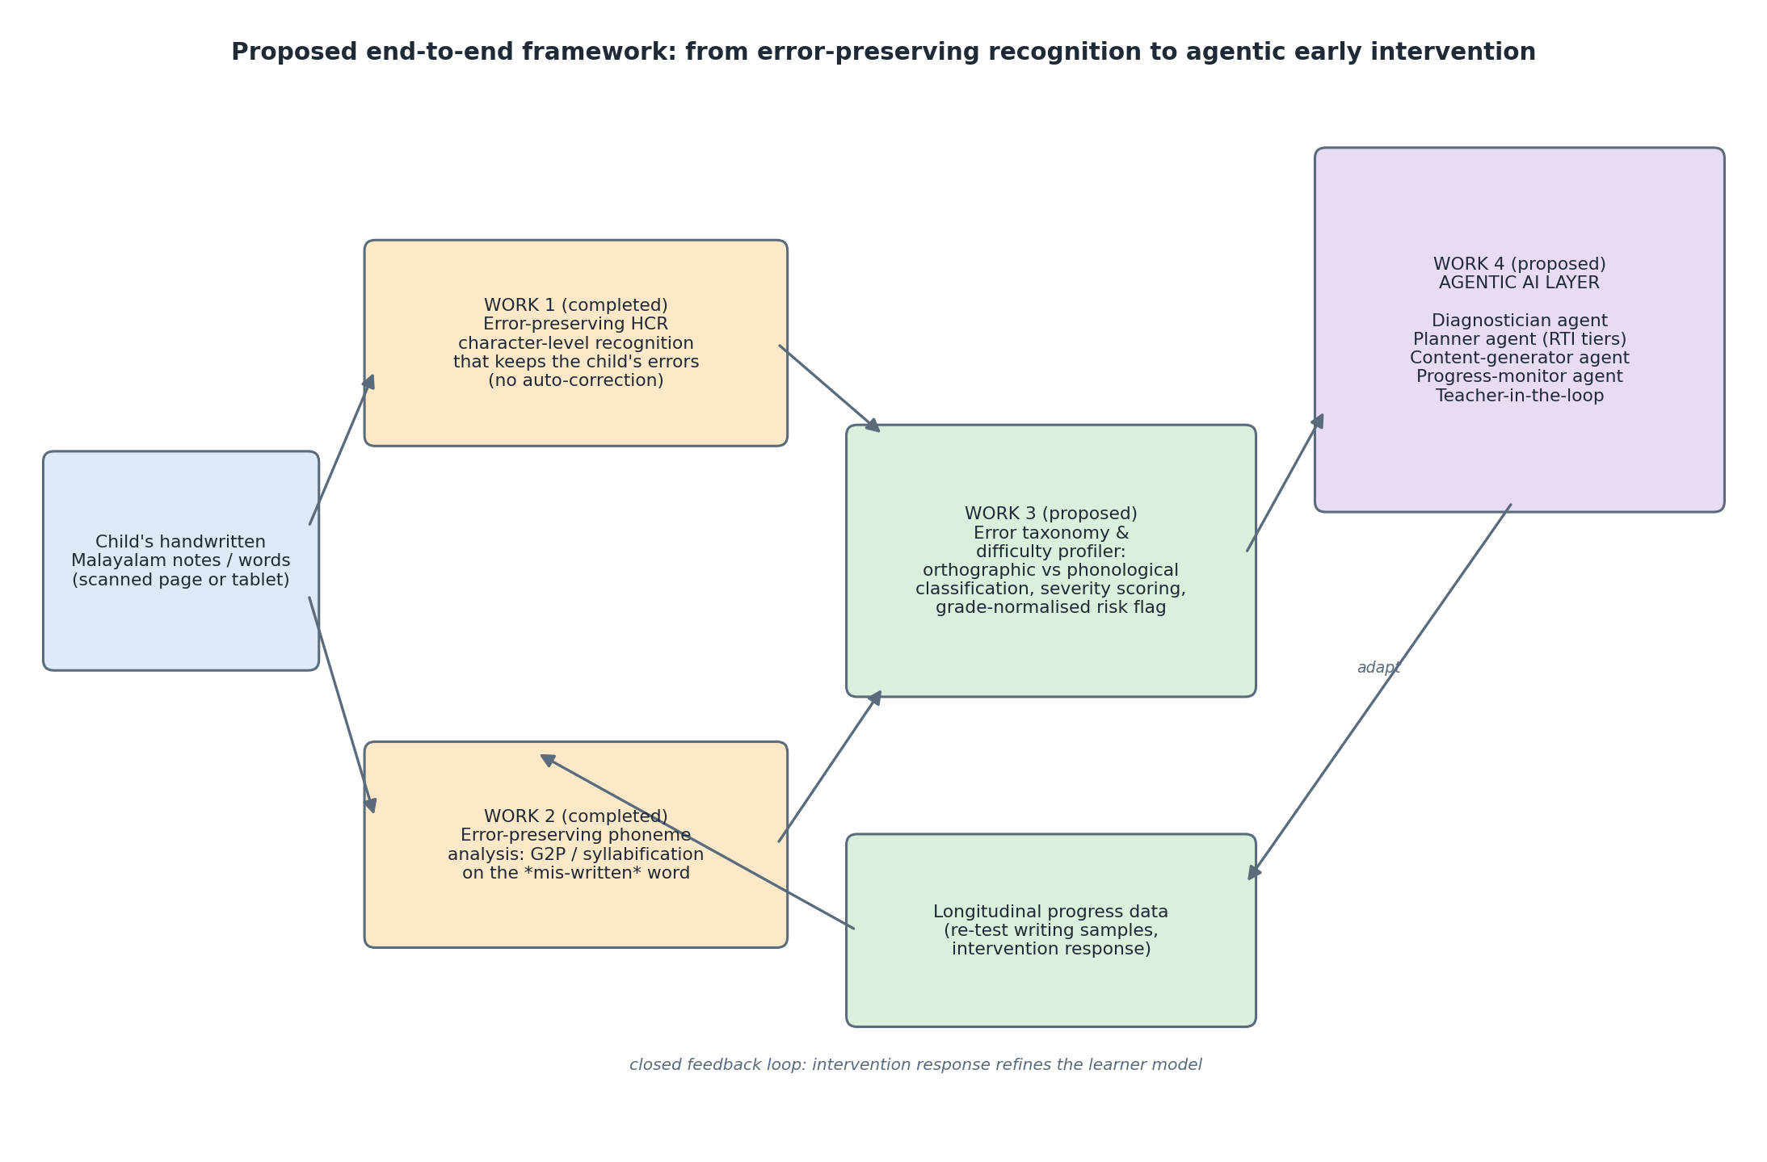
The Three-Pillar Framework
P1 See (HERA, under review) → P2 Hear (OSUR-G2P, under review) → P3 Understand & Act (agentic layer — the doctoral contribution). The feedback arrow: intervention response refines the learner model.

Slide 8
COMPLETED · UNDER REVIEW
P1 — HERA: Error-Preserving Recognition
Design: retrieval-only recognition — the language-model prior is removed from the loop entirely.
• Hierarchical 3-tier segmentation (VPP → Canny/contours → width fallback)
• Hybrid descriptor: frozen SigLIP-2 (768-d) + HOG (1,764-d) → 2,532-d vector
• HNSW nearest-neighbour retrieval + inverse-distance-weighted voting
• No lexicon, no beam search, no decoder → the retrieved label is the output
Knowledge base: 336,527 images · 634 Malayalam grapheme classes (public on Hugging Face)
0.17–0.20
CER on unseen children's handwriting (200-word / 50-word sets)
+14.1 pp
accuracy gain of hybrid descriptor over SigLIP-2 alone (ablation)
Outperforms Gemini 2.5 Pro, Sarvam AI, GPT-5.1, Claude Opus 4, and two PaddleOCR variants — by 18.8 to 60 CER points
Why it matters for the thesis: each output character is traceable to a retrieved neighbourhood — not a hidden sequence prior. Substitution, omission, and vowel-sign errors are preserved verbatim for downstream analysis.

Slide 9
COMPLETED · UNDER REVIEW
P2 — OSUR-G2P: Error-Preserving Phonological Analysis
Design: transcribe the mis-spelled word to IPA without correcting it.
• OSUR tokenizer — segments Malayalam into akshara units (clusters, matras, chillu, anusvara) that must not be split
• Per-step decoder-conditioned alignment — two instantiations: BiLSTM + positional-encoding attention; OSUR-Transformer
• GUPER — new grapheme-unit phoneme error rate for abugida scripts
• Dataset: 13,576 word–IPA pairs (3,800 authentic learner items), leakage-free word-disjoint protocol
• 12-rule error taxonomy — orthographic / phonological / phono-orthographic, derived from real learner data
0.84%
PER — BiLSTM instantiation (word-disjoint test)
2.82%
GUPER — unit-level error rate
Rule-based mlphon rejects 43.5% of authentic learner spellings — the exact inputs this framework is designed to transcribe
Example: "ക്ലാാസ്സ്" (doubled vowel diacritic for "ക്ലാസ്സ്") → OSUR isolates [ക്ലാാ][സ്സ്] → model transcribes /klaːaː/ faithfully. The preserved phoneme error is the diagnostic evidence for the agentic layer.

Slide 10
PROPOSED · DOCTORAL CORE
P3 — The Agentic Diagnostic-Intervention Layer
Longitudinal Learner Memory — structured per-child, per-error-class history built from HERA+G2P snapshots. Agents reason over this memory; they never compute trends in-context.
Error-Analysis Agent
Calls HERA + OSUR-G2P as tools; retrieves similar linguist-labeled cases (~1,000-instance gold set); classifies each error against the diagnostic schema with evidence traces.
Insight Agent (self-verifying)
Queries memory; calls deterministic stats tools (slope, change-point, mastery); issues improving / stagnant / worsening verdicts; critique–revise loop checks each claim against raw data.
Intervention Planner + Content Agent
RTI/MTSS-tiered plan (Tier 1→3); generates Malayalam practice AND the next probe, verified by OSUR/mlphon so drills target the intended phoneme contrast.
Orchestrator + Teacher Gate — every plan and insight passes human review; screening and support, never diagnosis
Probe mode: 10–15 grade-leveled dictation/picture-naming words every 2–3 weeks (mirrors RTI progress monitoring). The Content Agent generates the next probe — the intended word is never missing inside the loop. Free-writing analysis is scoped as future work.

Slide 11
Novelty: Five New Mechanisms (N1–N5)
Code | Mechanism | Claim
N1 | Longitudinal learner memory | First structured, per-error-class memory of handwriting-derived evidence for educational agents — in any language
N2 | Self-verifying insight generation | Critique–revise loop grounds each insight in raw data via tool calls — tackles LLM hallucination in child assessment
N3 | Evidence-traced insight language | Every insight is machine-checkable; introduces insight-faithfulness as a new measurable evaluation problem
N4 | Phonology-constrained content generation | Generated Malayalam drills verified by OSUR/mlphon — constraint-verified generation in a low-resource language
N5 | Tool-mediated numeracy | Agents call deterministic stats tools; ablation vs free-reasoning agents turns the design choice into an experiment
Layer-level claims: first agentic diagnostic-intervention system driven by handwriting evidence · first LLM-agent architecture grounded in RTI/MTSS · first agentic system with a provably error-preserving perception layer · closed causal loop — intervention effect measured by the same pipeline that triggered it.

Slide 12
Research Questions and Evaluation Plan
RQ1, RQ2 — answered (under review): error-preserving recognition (HERA, CER 0.17–0.20) and phonology (OSUR-G2P, PER 0.84%) outperform correction-oriented systems.
RQ3 (identification & insight): can a tool-augmented agent with longitudinal memory identify which specific difficulties a child shows, with evidence-traced insights validated against linguist labels and a NIMHANS-style instrument?
RQ3b (progress monitoring): do improving / stagnant / worsening verdicts match measured learning gains, with earlier signal than re-screening?
RQ4 (intervention): does the RTI-aligned agentic plan beat a static baseline on learning gains? RQ5: transfer to a second akshara script with script-level changes only.
Component | Metrics | Baselines
P1 HERA (done) | CER 0.20 / 0.17; per-class accuracy; +14.1 pp hybrid ablation | Gemini 2.5 Pro, Sarvam, GPT-5.1, Claude Opus 4, PaddleOCR ×2
P2 OSUR-G2P (done) | PER 0.84% / GUPER 2.82%; bigram-holdout stress test | Static-attention (2.96%); mlphon (rejects 43.5%)
P3a Insight / monitoring | AUC vs clinical assessment; classification F1 vs linguist labels; trajectory-verdict accuracy; insight-faithfulness | Free-reasoning LLM agent (no tools); human checklist; re-screening
P3b Intervention | Learning gain per error class; time-to-improvement; teacher acceptance | Static plan; monitoring-without-agents ablation; waitlist where ethical
Data assets in hand: 336,527-image character KB · 13,576 word–IPA pairs · ~1,000 linguist-labeled error instances (Haridas framework) · ethics approval AMRITNSOE/ADMN/DON03/2026/002 already in place.

Slide 13
Timeline and Publication Pipeline
Period | Milestone
Sem 1–2 | Diagnostic error schema (extend 12-rule taxonomy + visual/motoric classes); learner memory design; Error-Analysis Agent over the linguist-labeled set; ethics renewal for longitudinal collection
Sem 3 | Insight Agent with stats tools + self-verification loop; insight-faithfulness metric; N5 ablation (tool-mediated vs free-reasoning agents)
Sem 4 | Intervention Planner + Content Agent (phonology-constrained generation); probe design protocol; school partnership
Sem 5 | Longitudinal pilot in schools; at-risk validation against standard instrument; trajectory-verdict evaluation
Sem 6 | Cross-script transfer study (RQ5); intervention learning-gain analysis; thesis writing and submission
Publication pipeline:
• P1 HERA — under review (document analysis: IJDAR / ICDAR / DAS) • P2 OSUR-G2P — under review (NLP: SNCS / COLING / LREC)
• P3a diagnostic schema + longitudinal profiling — ACM IDC / assistive-tech • P3b agentic layer — AIED / EDM / ITS

Slide 14
Why This Research, and Why Now
• A real, unmet need: 1 in 6 Kerala children has a learning disorder; none are identified; early support works
• A proven foundation: two perception works completed and under review, with datasets and ethics approval in hand
• A defensible design: error preservation is architectural; agents orchestrate verified evidence — a claim backed by our own measurements, not preference
• A genuine gap: the first agentic diagnostic-intervention system driven by handwriting evidence — for Malayalam, designed to transfer across akshara scripts
The system never asks "does this child have a problem?" once — it continuously answers three questions: which difficulties, what to work on, and is it working?
Thank you — questions welcome

